Slide 1


Data Urbanism
scaling digital infrastructure with the mindset of a city builder
Gardens by the Bay, Singapore
Notes:
I’m thrilled to present Data Urbanism, a concept I’ve been developing for several years at the intersection of the built environment and digital infrastructure.
For over 15 years, my ‘office’ was the world of steel and concrete, where I helped deliver massive infrastructure projects like the Waterloo International terminal and Al Janoub Stadium. Today, as a Data Visualization Engineer, I’ve realized that building a data ecosystem requires the same rigor as building a city.
Using the RIBA Plan of Work as our guide, I’ll show you how we can move past 'shiny dashboards' to build digital environments that truly breathe. My hope is that through these projects, you’ll see my deep appreciation for both the design that inspires and the process that ensures it actually works.
When we look at a city like Singapore, we judge it by its skyline—iconic silhouettes like these Supertrees at Gardens by the Bay. But a city is more than its skyline. It is a living, breathing organism defined by its systems. A beautiful tower is uninhabitable if the elevators or plumbing fail. A city is only as healthy as the invisible machine that sustains it.
In our industry, we have a 'Skyline Problem.' We judge our success by the Dashboard—that shiny, colorful ornament we place on top of a business for the CEO. But the dashboard is just the tip of the iceberg.
This is where Data Urbanism comes in. It is the realization that the dashboard sits in a broader ecosystem.
In this world, we aren't just 'painters' of dashboards; we are the urbanists of a digital city. Today I want to show you how we can use an established architectural framework to make sure our digital cities actually breathe.

Slide 2
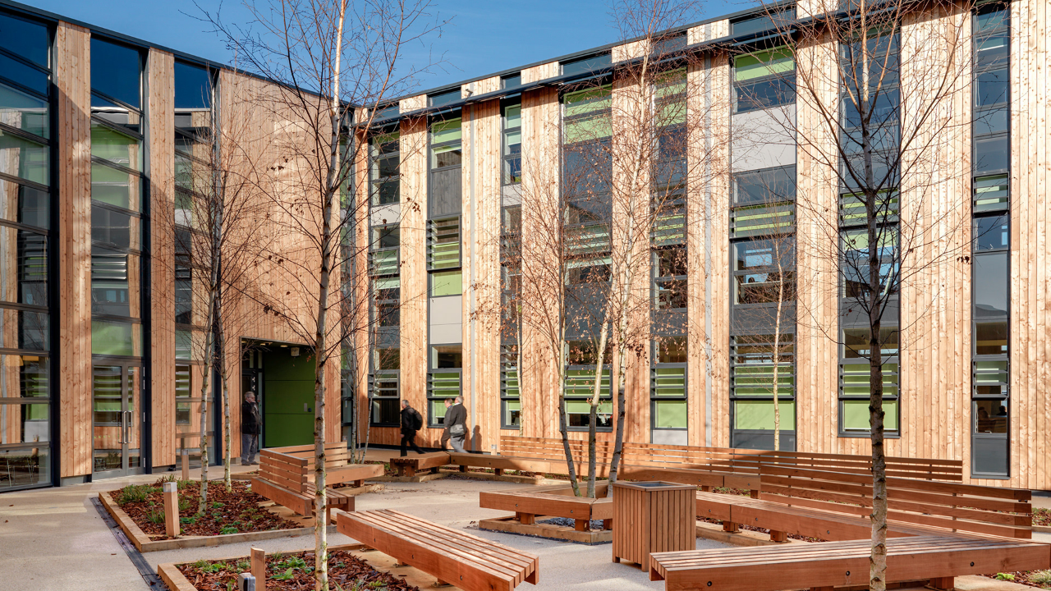
The Human City
built for the inhabitant
Woodland Trust HQ, Grantham, UK
Notes:
This is the Woodland Trust Headquarters. It’s built with massive timber frames and natural ventilation. The place just feels light. It’s designed to respond to the people inside it rather than forcing them to adapt to the building. It’s... hospitable.
In architecture, we have a specific way of making sure projects stay this focused on the user. It's the Royal Institute of British Architects’ Plan of Work. It’s an eight-stage lifecycle that guides a project from a blank sheet of paper to a living building. And the core rule of that plan is that you don't start by pouring concrete; you start by figuring out how a person is actually going to move through the space.
Think about how we usually start a project. We tend to ask, 'What data do we have available?' but that’s like starting a building by looking at a pile of bricks. Instead, we should be asking: 'What does this person actually need to know to feel confident in their job?' It’s about starting with the user, not the inventory.
If a business user has to go on a scavenger hunt just to find a single number, then the system isn’t really working for them. It’s the same as architecture—if a building is too confusing to walk through, it’s a design failure. We have to design for the human scale first.
So, let's look at how that architectural plan helps us keep things on track.

Slide 3
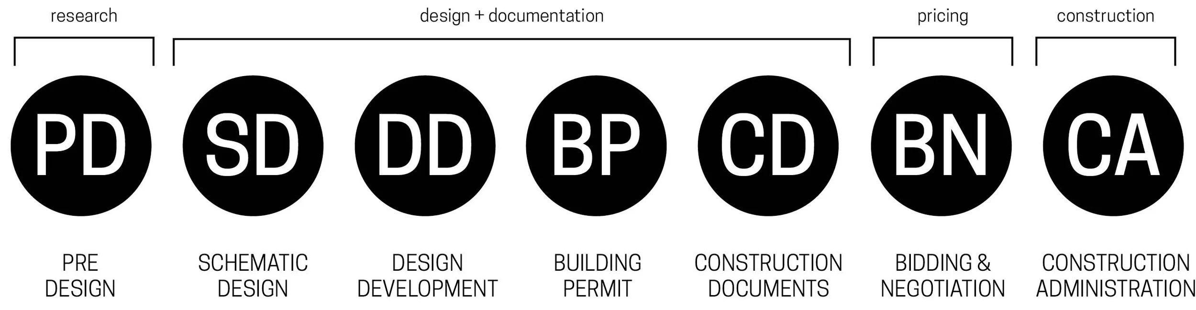
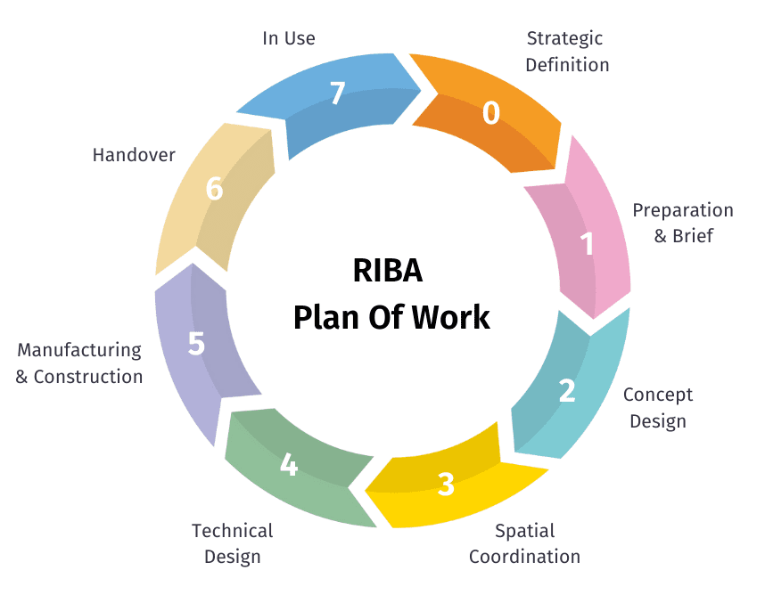
From Blueprints to Outcomes
LINEAR DELIVERY
OUTCOME-CENTRIC
Notes:
For a long time, architecture followed a pretty linear 'Waterfall' logic. You designed it, you built it, you handed over the keys, and you were done. On Budget, On Time and Still Standing? Success.
But in 2013, the RIBA Plan of Work went through a bit of a revolution. The industry realized that a finished building is the beginning. They stopped asking 'Is it finished?' and started asking 'How does it perform?' They began looking at actual outcomes—things ranging from energy efficiency to whether a hospital design has actually helped people heal better through design.
I think we’re still stuck in that older mindset. There’s a tendency to see our job as delivering a 'Product'. We hit 'Publish' in Tableau and move on.
But if I build a dashboard and nobody ever opens it, it's not a success. The 'North Star' has to be the actual business outcome. It’s about treating what we build as a Living Asset. Just like a modern building has sensors to monitor its 'vital signs,' we need to keep an eye on the health and impact of our data systems long after the 'construction' is over.

Slide 4
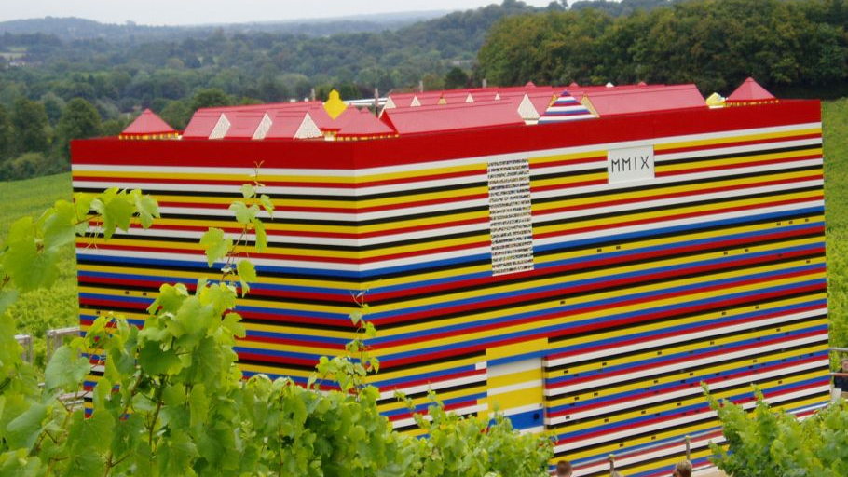
Fixed Units of Truth
set the foundation before a single line is drawn
Stage 0: Strategic Definition
Lego House, Surrey, UK
Notes:
we move into the circle at Stage 0, which is Strategic Definition. This is the part of the project that’s most tempting to skip or rush through, but it’s really where we handle the biggest contradictions.
Take the Lego House, for example. The brief was a paradox: a real, habitable home using 3.3 million Lego bricks. To make that work, we had to balance three very different 'truths' at the same time.
First, there was the Vision. The producers wanted it to look and feel exactly like it was made entirely of Lego. Then, there was the Physics. Technically, Lego can support the weight, but tolerances are microscopic. I actually spent a memorable day at work helping our engineers stress-test structural beams made of Lego bricks to see exactly when they’d fail. And finally, there was the Reality. For the realities of insurance and safety, we had to hide a secondary timber frame inside.
In the data world, Stage 0 is where we work through those contradictions. Clients come to us with a 'Lego Vision'—they want a novel, beautiful insight layer they can interact with. Our role is to define the hidden governance and the safety protocols—the wood frame—that ensures that vision doesn't collapse under technical or regulatory stress.
We’re defining the 'Why' and the 'Constraints' here, so we don't have to argue about them later when we’re already halfway through the build.

Slide 5
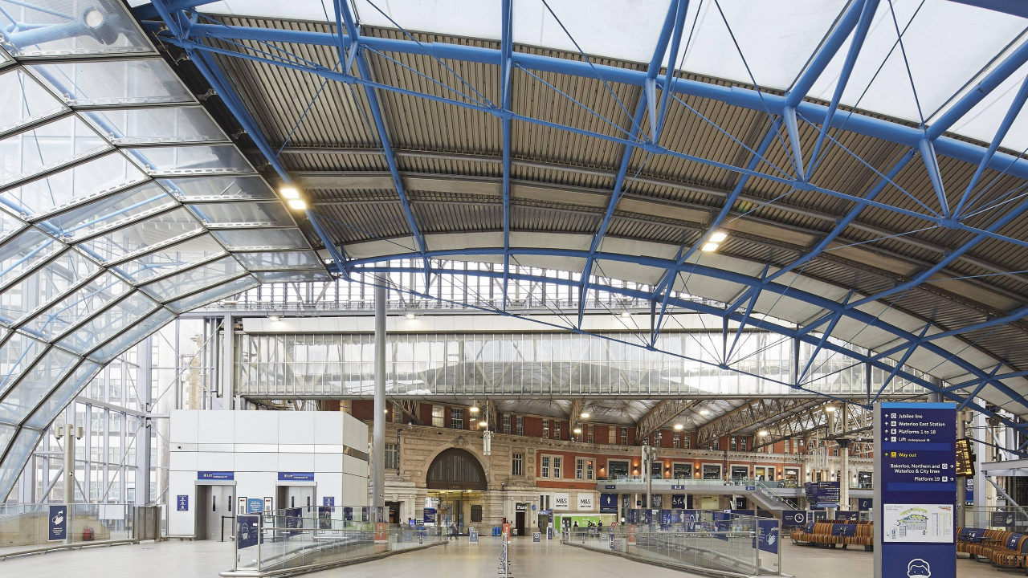
Heritage Audit
survey legacy data to unlock future potential
Stage 1: Feasibility & Site Survey
Waterloo International, London
Notes:
In Stage 1, we move into the Site Survey. I like to think of this through the lens of Waterloo International. When Eurostar moved out to St Pancras, they left behind five 'ghost' platforms right in the middle of Europe’s busiest station.
The challenge was to perform 'open-heart surgery' on a living terminal. We were weaving 21st-century infrastructure back into a Victorian domestic network without stopping a single commuter. In this stage, you don't just look at the blueprints—because quite often, the blueprints are wrong. You have to go under the floorboards.
As data professionals, we deal with this 'Waterloo Dilemma' all the time. We’re rarely building on a greenfield site.
We’re looking for the Heritage Assets—the legacy logic that is actually the 'load-bearing' truth of how the business functions. We’re also looking for Structural Decay, those toxic data habits that are like asbestos hidden in the walls, ready to contaminate the new build.

Slide 6
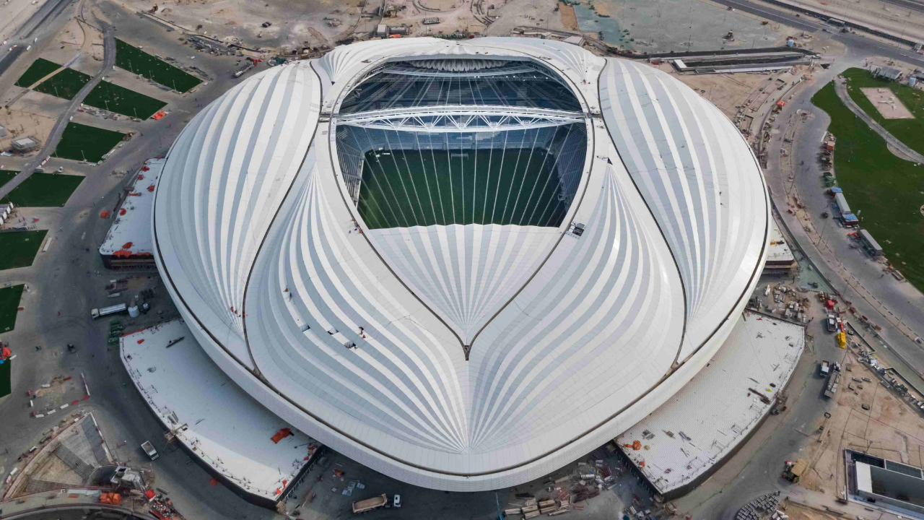
Mathematical Logic
turn impossible curves into buildable code
Stage 2: Concept Design
Al Janoub Stadium, Qatar
Notes:
once we’ve finished the survey, we move into Stage 2, which is Concept Design.
Zaha Hadid was famous for these 'unbuildable' curves. When you look at Al Janoub stadium, it almost looks like it was poured into place. But beneath fluid lines, there’s a massive amount of mathematical rigor.
Stage 2 is the moment where poetic visions meet the reality of the grid.
Our stakeholders often come to us with 'Curved Dreams.' They want 'Total Data Democracy,' 'Real-time Global Insights,' or 'Predictive AI.' These visions are usually beautiful, but they can be aerodynamically impossible.
Our job in Stage 2 isn't to say 'no' to the curve. It’s to find the Technical Logic that makes it hold weight. We’re looking at the geometry of the data—how we break down a massive, 'curved' business vision into a modular schema that actually works.

Slide 7
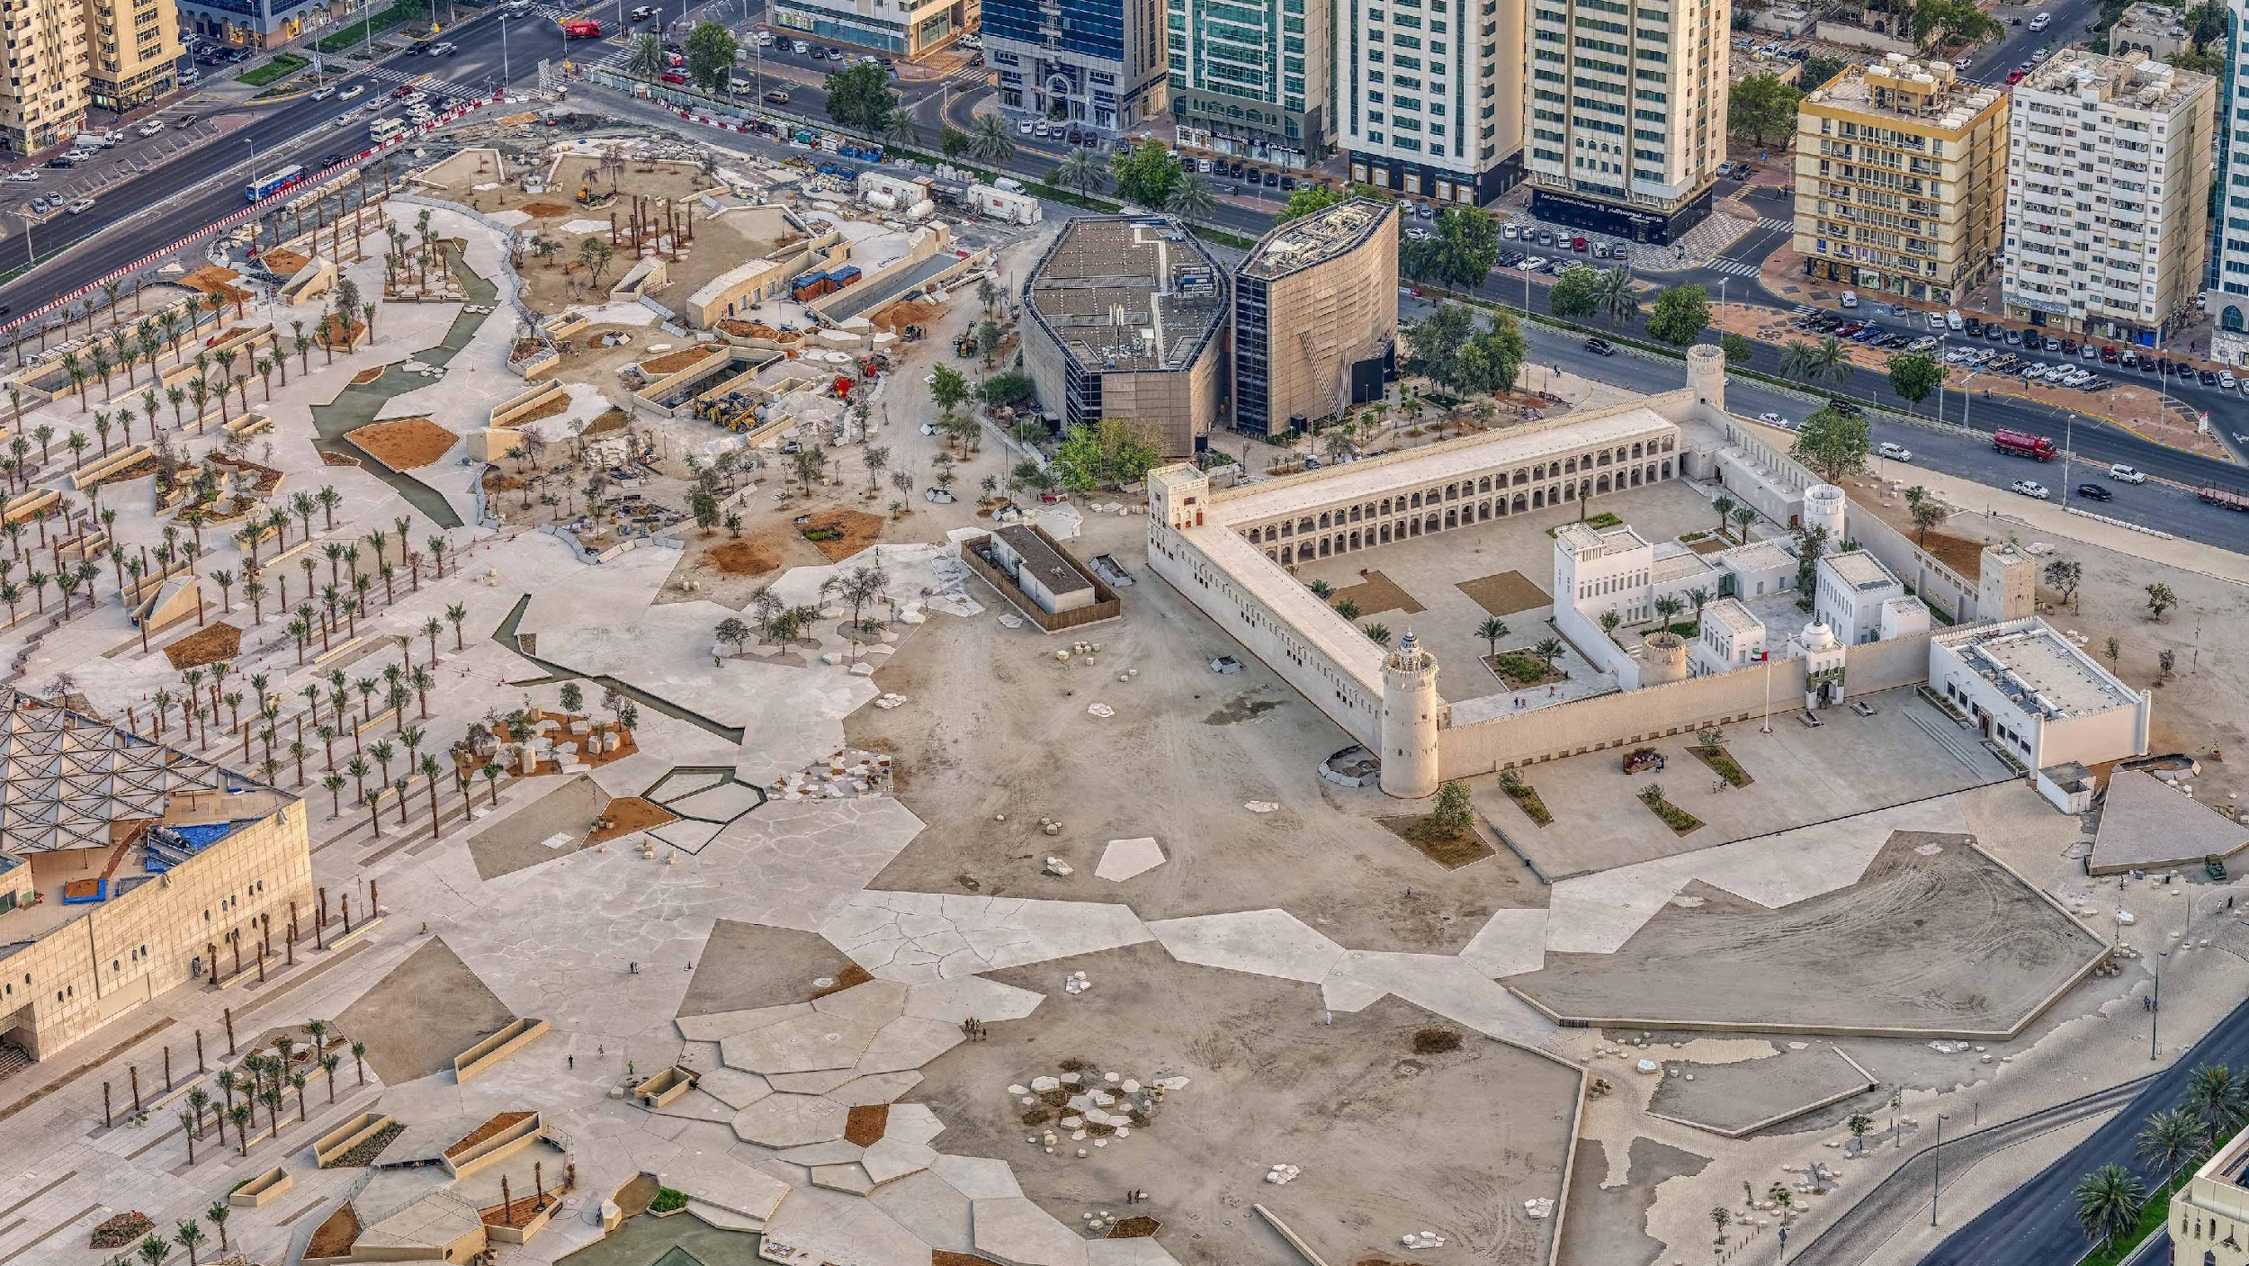
Digital Twins
buildings as data, data as a living model
Stage 3: Spatial Coordination
Qasr al Hosn, Abu Dhabi
Notes:
In Stage 3, we get into Spatial Coordination. When we worked on Qasr al Hosn in Abu Dhabi, we didn't start with a hand-sketch. We started with a LIDAR scan, peppering this ancient stone fort with millions of laser points to create a 'Point Cloud'—a high-fidelity digital ghost of the physical site.
This fed directly into our BIM model, or Building Information Modeling. With BIM, a building isn’t just a static 2D plan anymore. It’s a 3D database. Every stone, every beam, and every bolt has metadata attached to it—we know its material, its weight, its cost, and its history.
In the old world of data, we mostly built 'charts'—which are really just 2D blueprints of information. They’re static snapshots of the past. But in Data Urbanism, we’re trying to build a Digital Twin of the business.
Just like that BIM model knows where a bolt came from, a modern data stack—using tools like dbt and Snowflake—gives every metric a lineage. We know where the data was 'quarried,' who transformed it, and exactly how much it costs us to compute.
But the most important part of Stage 3 for an architect is Clash Detection. We’re checking the model to see if the plumbing hits the electrical lines before we start building. In data, we’re checking for Logic Clashes. We’re asking: 'Does the Marketing definition of a customer collide with the Finance definition?'
We’re resolving those conflicts in the digital model so they don't become expensive mistakes on the 'construction site' later.

Slide 8
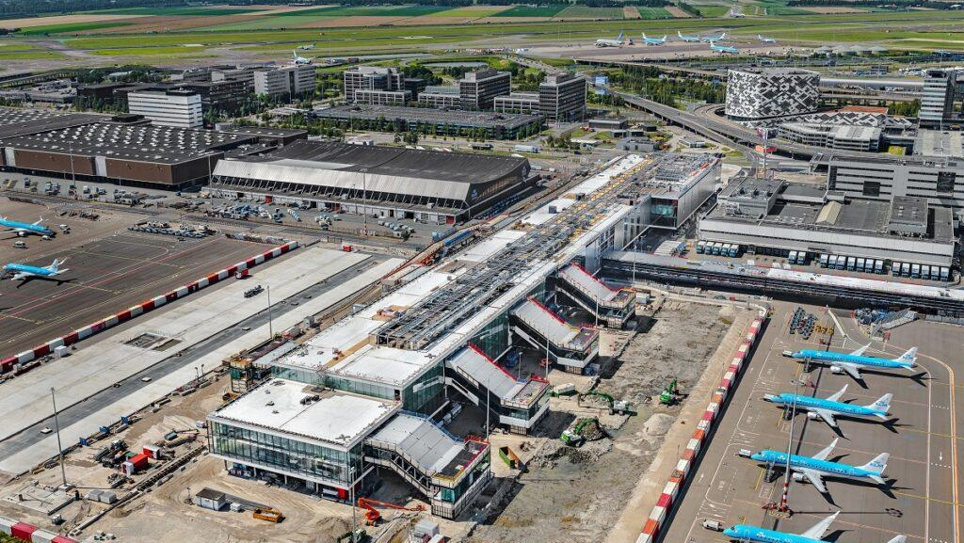
Precise Blueprints
coordinating high-stakes flow and digital movement
Stage 4: Technical Design
Schiphol Pier A, Netherlands
Notes:
Once we’ve got the coordination down, we move into Stage 4, which is Technical Design. Schiphol Airport is a good example for this because adding Pier A was a bit like trying to add a new cylinder to a running engine while it's still humming. You don’t really get to 'beta test' a boarding gate.
Everything—every bolt, HVAC sensor and security interface—has to be specified. If the technical design is only 99% right, there’s a genuine risk a design decision causes the busiest hub in Europe to grind to a halt. In an airport, precision isn’t an aspirational goal; it’s a safety requirement.
In the data world, Stage 4 is where the architectural vision becomes actual Production Code. This is where we’re finalizing the ETL logic, the row-level security, and the API handshakes.
Just like that new pier had to plug into Schiphol’s existing baggage and security systems without a glitch, new data models have to fit into existing systems. We aren't there to break the 'legacy' gates just to build the new ones.
It really comes down to the precision of the 'joins.' If a SQL join is only 99% right, you don't just lose 1% of the data—you can lose the trust of the organization.
We also treat security as part of the infrastructure, not something we bolt on at the end. We design the 'corridors' of data access so the right people can move through the system smoothly, and the wrong people are stopped before they even get close to the gate.

Slide 9

Supply Chain of Truth
DfMA: prefabricated units built from pure data
Stage 5: Manufacturing and Construction
Shell Modular DfMA Stations, Europe
Notes:
Stage 5 is where we finally start building, but sometimes it looks a bit different than you might expect. Shell had a massive problem: an aging network of service stations across Europe, and if we had treated every single one as a bespoke project, it would have taken decades to modernize them.
So, we shifted our mindset from 'construction' to Manufacturing. We used a process called DfMA—Design for Manufacture and Assembly. Instead of cutting steel or pouring specialized concrete on-site, we built modular 'cassettes'—pre-fabricated shop units and tech hubs—in a controlled factory environment. By the time we got to the site, the 'build' was really just an assembly. What used to take months was suddenly taking weeks.
This is exactly how we approach the modern data stack now. We aren't 'hand-coding' every single report from scratch anymore; we’re managing a Data Supply Chain.
In tools like Snowflake and dbt, we use these 'pre-fab' blocks of code. Once we build a standardized 'Sales' or 'Customer' module, it becomes a part we can use across the entire enterprise.
Because we’re assembling pre-tested parts rather than 'cutting steel' on-site every time, we can start to move at the speed of the business.

Slide 10

Operational Readiness
hand over a living asset, not just a building
Stage 6: Handover
Istanbul New ATC
Notes:
After construction we reach Stage 6, which is Handover. For this, I think of the new airport in Istanbul. It is designed to be the most connective hub on the planet. To manage that kind of ambition, they commissioned this landmark Air Traffic Control tower, which we designed in a collaboration with Pininfarina—the same folks who design for Ferrari.
It’s a beautiful building, but in Stage 6, beauty takes a backseat to Operational Readiness. Handover is the moment the people take command of the nerve center. A tower is essentially the brain of the airport, and it only 'works' when the controllers are empowered to manage the hundreds of flights moving through their airspace every hour.
We see the same transition in our data projects. We can spend months building a really sophisticated 'hub' for a client’s information, but the project isn't a success until the client can actually 'fly' the system themselves.
This is the point where we move from being the 'Consultant' to being the 'Coach.' We want to make sure the client isn't just handed a login and a 'good luck'; they need to be trained to interpret the signals. We’re providing the 'radar' and the 'radio'—the dashboards and the documentation—so they can keep their operations moving safely.
Our goal is to leave the client standing in their own 'ATC tower,' looking out over their business with clarity

Slide 11
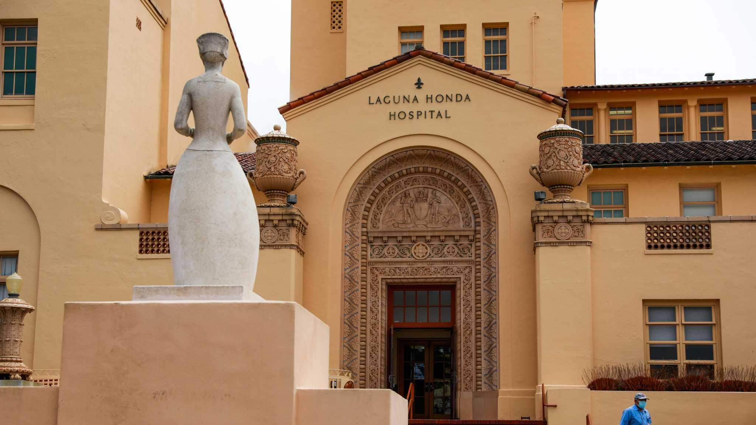
Living Ecosystem
performance, resilience and the human outcome
Stage 7: In Use
Laguna Honda Hospital, San Francisco
Notes:
I want to end the framework right where I started my career: at Laguna Honda Hospital. It’s a San Francisco institution, quite literally. It’s been dedicated to caring for the city’s most vulnerable people since the Gold Rush. When I walked through those doors, they were still using 'Nightingale Wings'— massive, open-air wards that hadn't really changed since the 1800s.
Modernizing Laguna Honda was spurred by regulations following the Northridge earthquake - but its ambition was broader; it was about moving into a sustainable future. It eventually became the first LEED-certified 'Green' hospital in California. For me, the real lesson wasn't in the certification; it was the realization that a building—or a city—is never really 'finished.'
In Stage 7, which we call 'Use,' the architects have all gone home. This is where we look at 'Post-Occupancy.' We’re asking the big questions: Is the building actually serving the people inside? Is it healthy? Is it evolving?
In our world, Stage 7 is that first year after the consultants leave. Success isn't 'Launch'—it’s Adoption. Is the data still clean? Are people actually using it? How do we monitor the 'vital signs' of our data to make sure the system hasn't just been abandoned.
I also like to think about this as the 'Green Data Stack.' Just like Laguna Honda is environmentally sustainable, we should be aiming for data sustainability: a stack that’s efficient to run and is easy for the client to maintain without needing an army of specialists.
We’re trying to build for longevity.

Slide 12
Thank you

Slide 13
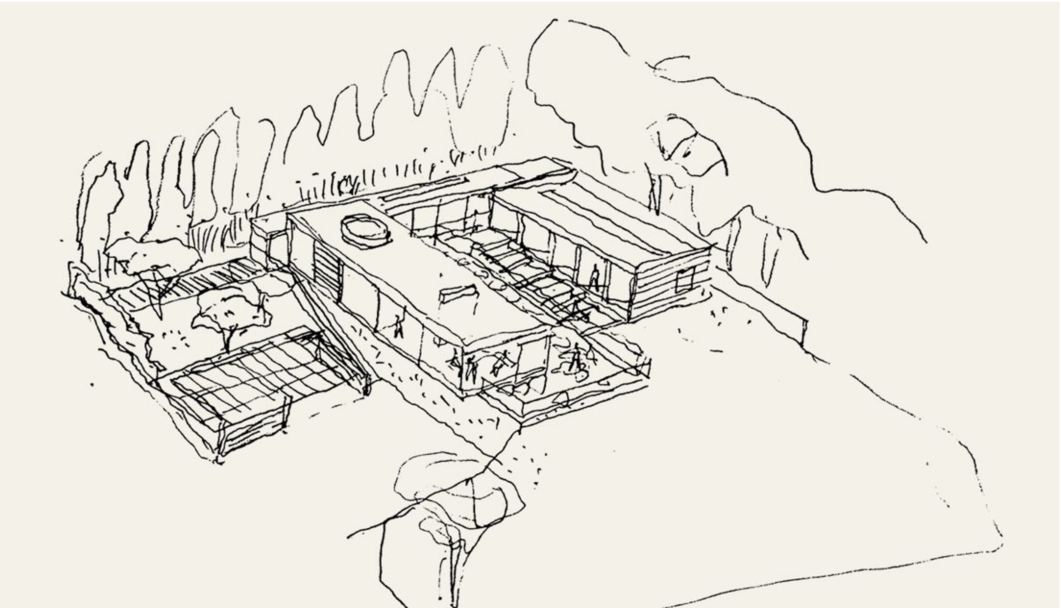
Furniture v Foundation
data as load bearing
Private Residence, Guildford, England
Notes:
I worked at a boutique architectural practice in London. I remember a residential project where we were deep into the 'Technical Design' phase. The foundations were set, the steel was specified.
Then, the client had a 'simple' idea. They wanted to move a kitchen island from one side of the kitchen to another. They also changed their minds about several finishes and fixtures.
In their mind, it was a couple of minor adjustments. Unfortunately not. There were implications to multiple services, requiring coordination and permit approvals. And those finishes and fixtures? Well, they had the misfortune of changing their minds right in the peak of the European holiday period when none of our suppliers were even picking up the phone.
I see this happen in Data Visualization. A stakeholder asks to 'just change the filter' or 'add one more data source.' They think they are moving furniture; they don't realize (or necessarily care!) they are asking us to move a load-bearing wall.
I think one reason this happens is that the data world lacks a common language for stages of maturity. We haven't had our own RIBA Plan of Work—a standardized map that tells us exactly when a design is 'fluid' and when the concrete is 'set.'
Let’s look at how the physical world solves this, and what we can steal from them.

Slide 14
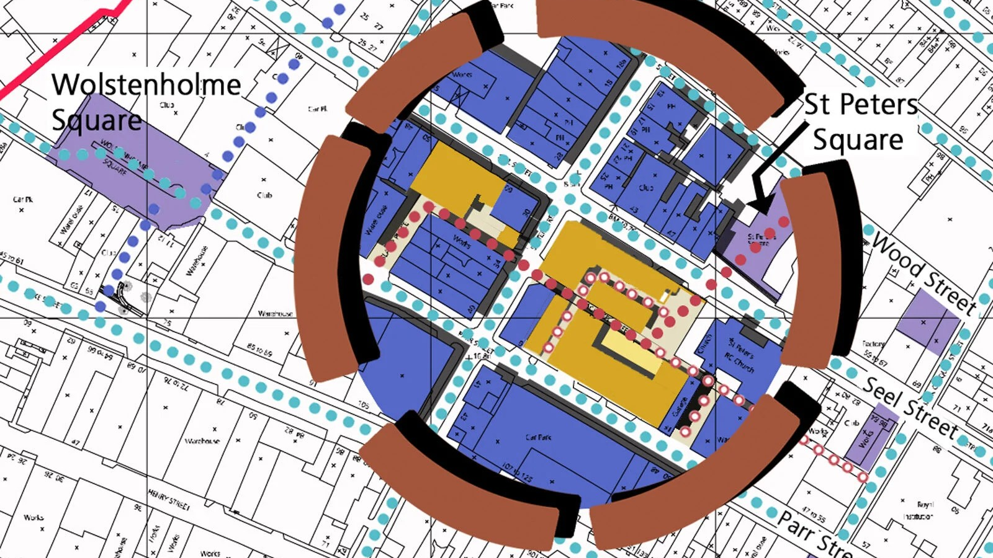
The Wayfinding Gap
role of the RIBA Client Advisor
Frenson Estate, Liverpool, England
Notes:
Between the vision of the architecture and the reality of the construction, there’s usually a bit of a gap. It’s that middle phase where things can start to feel a little overwhelming. This is the Frenson Estate Masterplan, it’s a drawing of relationships. It shows how everything connects.
In the RIBA framework, this is where the Client Advisor steps in. I think of them as 'Wayfinders.' When technical complexity gets really deep and the client starts to feel like they’re losing sight of the horizon, the Advisor is the one who points back to the masterplan to show them where they are.
In the data world, we do the exact same thing. We’re there to make sure that even when the technical work gets complicated, the project never drifts away from the broader business strategy. We’re keeping the map open while the buildings are going up.

Slide 15
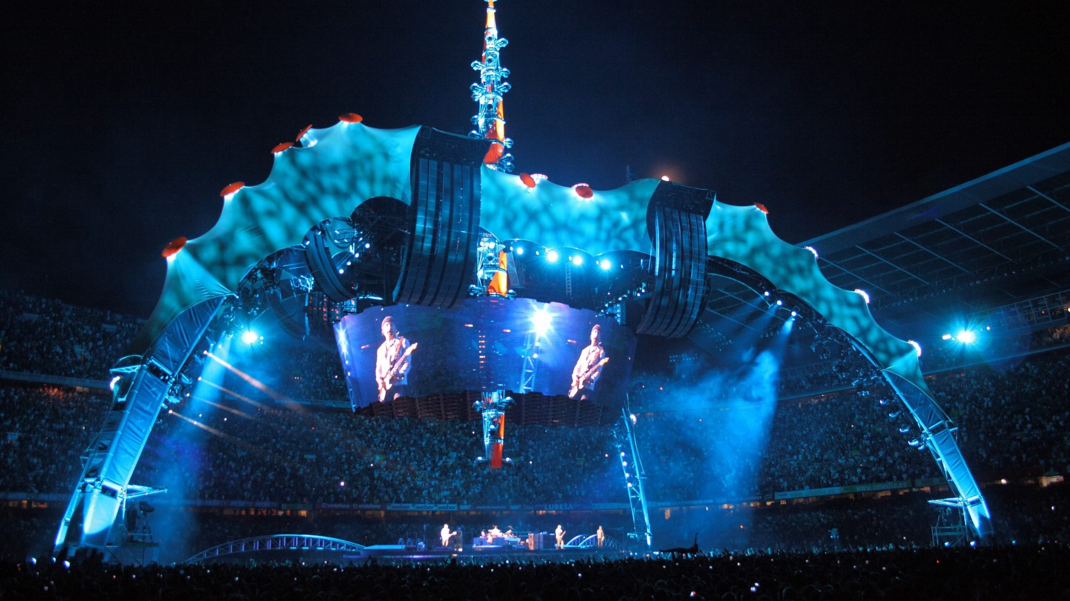
Adaptive Reuse
the permanence of temporary
U2 360 Tour “Claw” Stages
Notes:
We started today looking at the Supertrees—a machine disguised as nature. We’re ending with this: The Claw.
For most people, this was just a stage for a rock concert. It was temporary. It was meant to be dismantled and forgotten once the music stopped. But because the engineering was so rigorous—because the data behind its structural logic was so sound—it didn't disappear.
It became 'The Big Rig.' It became a permanent piece of the city’s bones.
And that is the true heart of Data Urbanism. We aren't just building for the next five years or the next 'show.' We are coding the skeleton of the future.

